Slide 1
Grand Marina IoT Security
How layered controls protected the hotel’s water-monitoring pipeline
Sok Leng Chan · Cybersecurity Extern · August 2026
Notes:
This project protects the Grand Marina Hotel’s water-monitoring pipeline. The main goal is to make sure the dashboard receives data that is private, comes from an approved device, has not been changed, and is still current.
[Sources]
- User-provided capstone project and presentation.

Slide 2
01
Unprotected MQTT Traffic Exposes Hotel Operations
Three realistic attack paths can turn sensor access into service disruption, property risk, and poor operational decisions.
Eavesdropping
Data Injection
Replay Attacks
A forged reading can trigger false alarms, unnecessary shutoffs, or unsafe decisions. Device and message checks prevent fake data from appearing trusted.
Without encryption, someone on the network could read pressure and flow values. The data reveals operating patterns and can support a later attack.
An attacker can resend an old valid reading to hide a new leak or pressure spike. Freshness checks reject stale, duplicate, and out-of-order data.
Business impact: compromised telemetry can disrupt service, damage property, and undermine guest trust.
Notes:
Before the defenses were added, an attacker had three realistic options. They could read the traffic, submit a false value, or resend an old value. Each one can create an operational problem because hotel staff may act on information that looks normal but is not trustworthy.
[Sources]
- Threat scenarios documented in the user-provided project.

Slide 3
02
Four Defenses Close Four Different Security Gaps
Each layer proves a different part of trust: a private connection, an approved device, an unchanged message, and a current reading.
Defense 1
Defense 2
Defense 3
Defense 4
TLS
mTLS
HMAC
Timestamp + Sequence
Encrypts traffic between the publisher, broker, and subscriber. Stops network observers from reading or changing telemetry in transit.
Both sides present trusted certificates before data is accepted. Blocks unknown devices, fake publishers, and unauthorized subscribers.
Adds a keyed signature to every payload. Any change to the reading, device ID, timestamp, or sequence produces a mismatch and rejection.
Rejects messages older than 30 seconds, duplicated, or out of order. Prevents captured valid messages from being reused.
Remove one layer and the system loses confidentiality, device trust, message integrity, or replay protection.
Notes:
The four defenses are designed to work together. TLS protects the connection, mTLS confirms the device, HMAC protects the message, and the timestamp plus sequence counter protects freshness. If one layer is removed, one part of trust is no longer proven.
[Sources]
- Controls implemented in the user-provided project.

Slide 4
03
Only Validated Messages Reach the Dashboard
Controls operate at both the connection level and the individual-message level before staff can see or act on a reading.
Validation Flow
SENSOR PUBLISHER
Creates pressure and flow readings
Adds timestamp, sequence, and HMAC
MOSQUITTO BROKER
Encrypts traffic with TLS
Verifies the device certificate with mTLS
SECURE SUBSCRIBER
Rebuilds and compares the HMAC
Checks message age and sequence order
DASHBOARD
Updates telemetry or records the rejection
1. Connection trust — TLS encrypts the session; mTLS accepts only approved certificates.
2. Message integrity — HMAC confirms that protected fields were not changed after publishing.
3. Freshness — Messages older than 30 seconds, duplicated, or out of order are rejected.
4. Visible outcome — Valid data updates the gauges; rejected data is logged with the failure reason.
Notes:
A reading passes through several checks before it reaches the dashboard. The broker first checks the encrypted connection and the device certificate. The subscriber then checks the signature, age, and sequence. A valid message updates the dashboard; a failed check creates a security event instead.
[Sources]
- Validation flow implemented in the user-provided project.

Slide 5
04
Combined Defenses Blocked Every Tested Attack
Each attack was stopped by the control designed for that failure mode, and no malicious reading reached the operational view.
Attack | Attacker objective | Defense chain | Evidence and outcome
Eavesdrop | Read sensor traffic and operating patterns | TLS | Traffic remained encrypted; readable sensor payloads were not exposed
Inject fake data | Make a forged pressure or flow reading look trusted | mTLS + HMAC | Certificate and signature checks rejected untrusted or altered data
Replay | Resend a previously valid reading | Timestamp + sequence | Stale, duplicate, and out-of-order messages were rejected
0 of 15 attacks succeeded | 100% blocked
Notes:
The combined defense blocked all fifteen simulated attacks. The result matters because each attack was stopped by the expected control. This shows that the layers are not duplicates; each one closes a different gap.
[Sources]
- User-provided test result: 15 of 15 simulated attacks blocked.

Slide 6
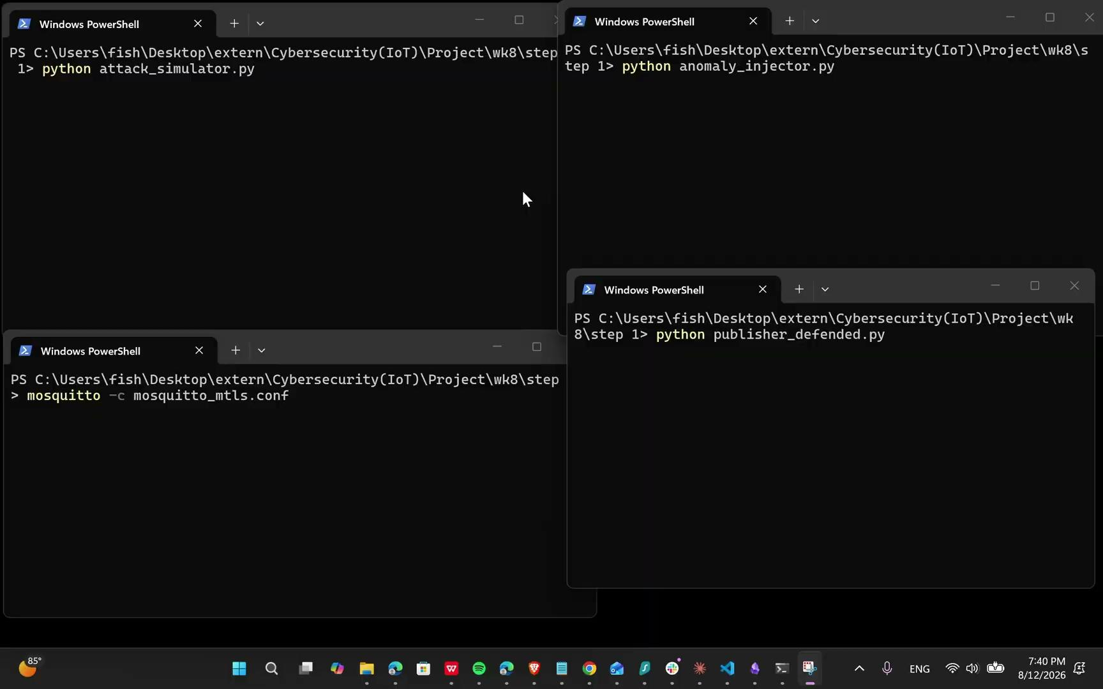
05
The Simulator Reproduced Each Attack on Demand
Separate terminals reproduced eavesdropping, false-data injection, and replay attempts. Each run verified terminal rejection and dashboard logging.
Watch the live demonstration →
Notes:
The simulator created the three attack types in separate terminals so the tests could be repeated. I checked both sides of the result: the terminal showed the rejection, and the dashboard logged the security event without accepting the malicious reading.
[Sources]
- User-provided terminal screenshot and demonstration link.

Slide 7
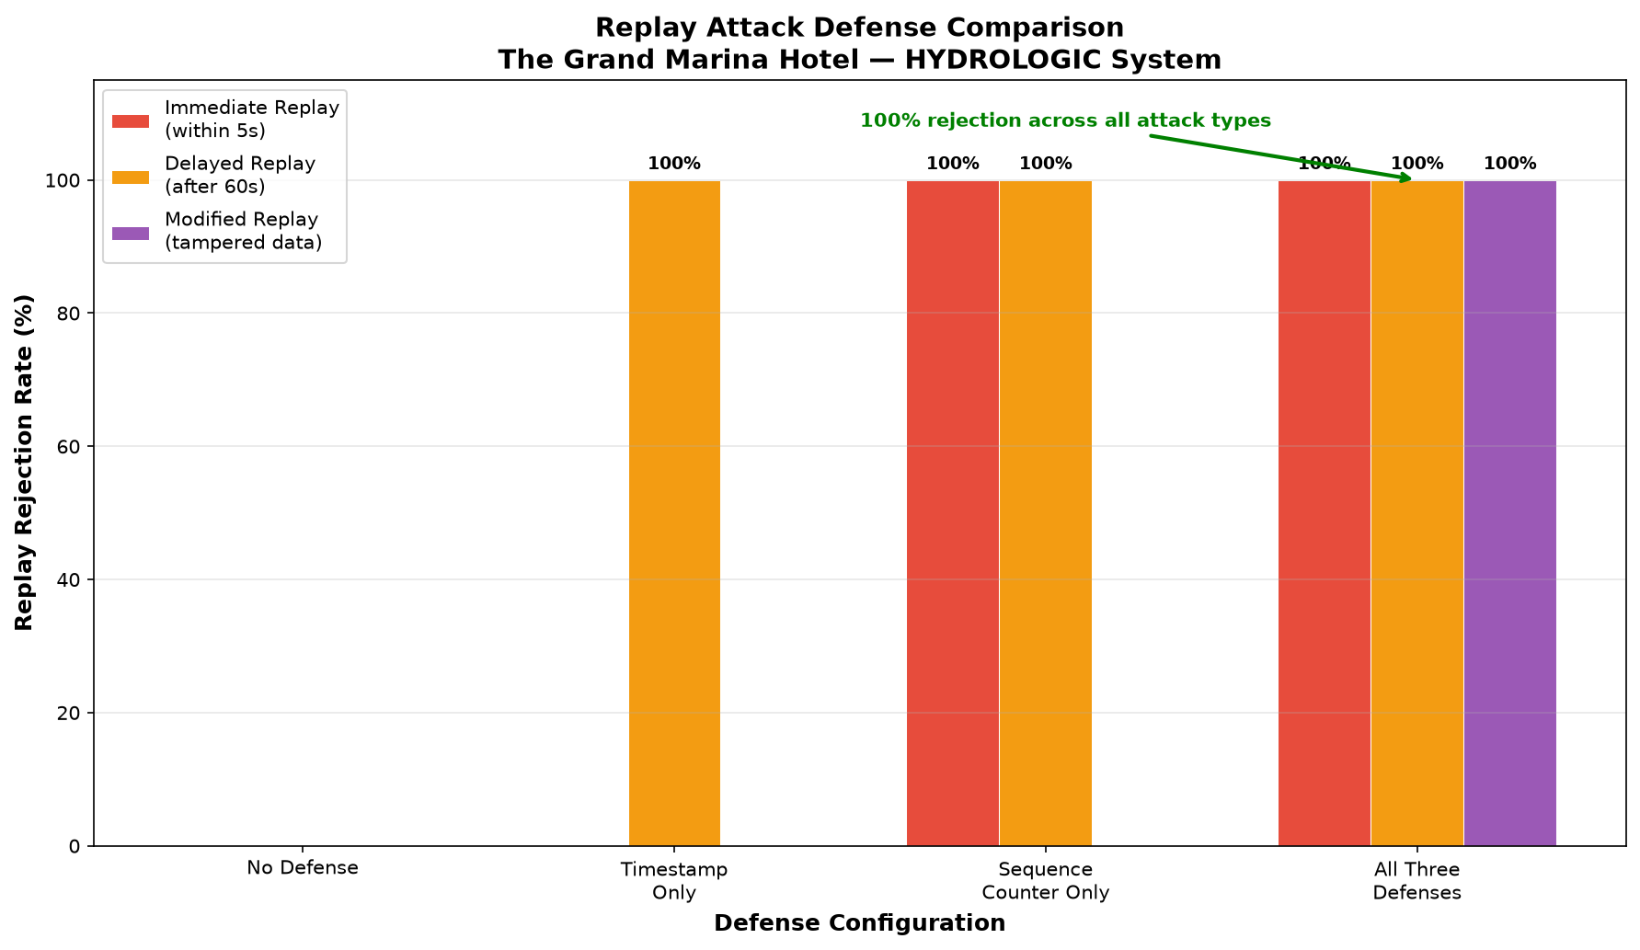
06
Replay Protection Required More Than One Check
Timestamp-only and sequence-only defenses each left replay variants uncovered. The complete defense chain rejected every replay tested.
Notes:
Replay attacks can look different. Some are immediate duplicates, some are delayed, and some have been changed. A timestamp or sequence counter by itself did not cover every form. The combined checks rejected every replay variant tested.
[Sources]
- User-provided replay comparison chart.

Slide 8
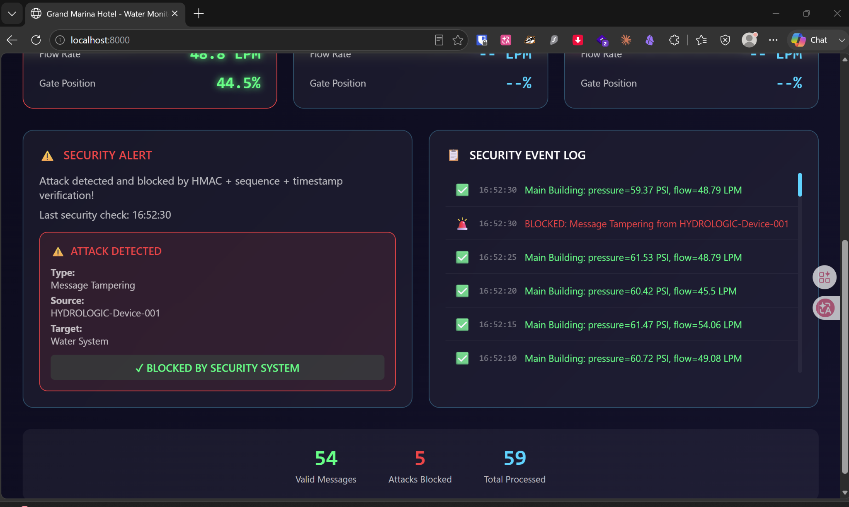
07
Every Valid Message Accepted; Every Attack Rejected
The dashboard processed 59 messages: 54 legitimate readings updated operations, while 5 attack messages were blocked and logged without interrupting normal telemetry.
Notes:
This screenshot shows the system separating normal activity from attack traffic. Fifty-four valid messages continued to update the dashboard, while five malicious messages were blocked and recorded. Security therefore protected the system without stopping normal telemetry.
[Sources]
- User-provided dashboard screenshot showing 59 total messages, 54 valid messages, and 5 blocked attacks.

Slide 9
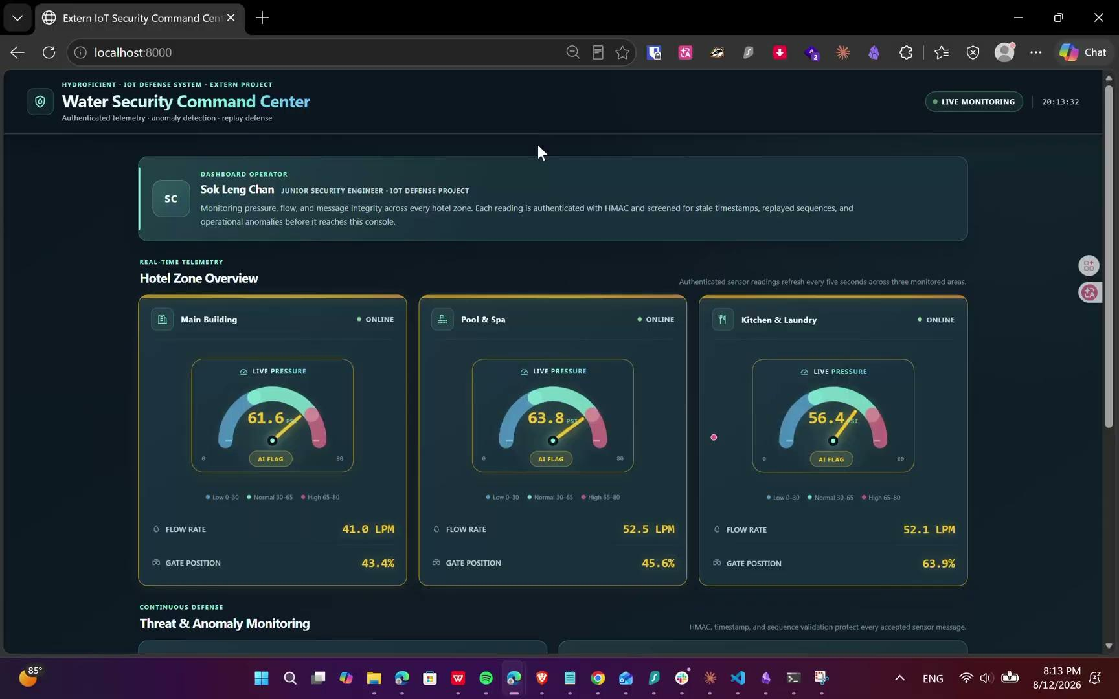
08
One Dashboard Unifies Security and Operations
The operator sees live pressure, flow rate, gate position, device status, anomaly rules, and rejected-message evidence across three hotel zones.
Notes:
The dashboard gives the operator one view of both water conditions and security. It covers three hotel zones and shows pressure, flow, gate position, device connection, anomaly status, and rejected-message evidence. That makes a technical security result easier to use during hotel operations.
[Sources]
- User-provided custom dashboard screenshot.

Slide 10
09
AI Catches Patterns the Security Rules Cannot See
Isolation Forest scores each validated MQTT message after identity, integrity, and freshness checks pass.
Normal
AI Flagged
Blocked
Passed every security check, but the combination of readings looked unusual.
Highlighted orange for staff review.
Passed every security check and matched expected pressure, flow, and gate behavior.
Displayed as trusted telemetry.
Failed HMAC, timestamp, or sequence validation.
Rejected before it could update the dashboard.
Isolation Forest (0.05) | Precision 0.736 | Recall 0.780 | F1 0.757
0.10 contamination raised false positives from 14 to 65 for only one additional true positive.
Notes:
[Sources]
- User-provided Anomaly Detection Results - Sok Leng Chan.pdf
- User-provided IoT project _Additional Slides.pptx

Slide 11
10
AI and Rules Operate Together in Real Time
Four coordinated services reproduce trusted traffic, known attacks, and unusual sensor patterns against the same secured pipeline.
Live test: broker + defended publisher + attack simulator + anomaly injector →
Notes:
[Sources]
- User-provided live test environment screenshot from IoT project _Additional Slides.pptx

Slide 12
11
AI Decisions Appear Instantly on the Dashboard
Green confirms trusted telemetry, orange marks an unusual pattern for review, and red records a blocked security failure.
Notes:
[Sources]
- User-provided AI dashboard screenshot from IoT project _Additional Slides.pptx

Slide 13
12
Testing Revealed Four Production Priorities
The prototype worked—and clarified which controls, trust boundaries, tests, and limitations matter most for the next security cycle.
1
Layered controls are essential
mTLS proves device identity, HMAC protects every reading, and freshness checks block reuse. No single control covers all three failure modes.
2
Security must cover the full pipeline
Publisher, broker, subscriber, and dashboard are separate trust boundaries. A weakness in any stage can undermine the entire system.
3
Attack simulation validates assumptions
Normal operation only proves that data flows. Controlled attacks show whether forged, stale, and unauthorized messages fail for the expected reason.
4
The evidence has defined limits
The lab covered eavesdropping, injection, and replay. Production readiness also needs outage, certificate-theft, denial-of-service, and recovery testing.
Notes:
The testing produced four main lessons. Layering is necessary, the entire pipeline needs protection, attack simulation provides stronger evidence than normal operation, and the current test scope still has limits. These lessons define what a production phase should address next.
[Sources]
- Findings derived from the user-provided implementation and tests.

Slide 14
13
Four Actions Move the Prototype Toward Production
Grand Marina can strengthen the protection while keeping ownership, monitoring, and recovery procedures clear for the operating team.
1
Automate certificate lifecycle
Issue, rotate, expire, and revoke device certificates automatically. A lost or stolen certificate should not remain trusted.
2
Protect signing keys
Store HMAC secrets outside source code and assign a unique key to each device. One compromised sensor should not expose the whole fleet.
3
Centralize security monitoring
Send broker logs, certificate failures, anomaly alerts, and dashboard rejections to one SIEM or monitoring queue with escalation rules.
4
Expand testing and recovery
Test certificate theft, denial-of-service, broker outages, and key rotation. Document response ownership, restoration steps, and evidence retention.
Notes:
The next steps focus on keeping the protection reliable over time. Certificates must be renewed and revoked, signing keys must be isolated, alerts need one monitoring process, and the team should practice outages and recovery. These actions move the prototype toward a system the hotel can operate safely.
[Sources]
- Recommendations based on the user-provided prototype findings.

Slide 15
100% Blocked
15 simulated attacks rejected while legitimate telemetry continued to reach the dashboard.
Notes:
The final result is that all tested attacks were blocked while valid messages continued to reach the dashboard. The prototype shows that layered defenses can make connected hotel operations more trustworthy without hiding the outcome from staff.
[Sources]
- User-provided capstone project and test results.

